Slide 1

PULSE Enhancing Elderly Care Through Advanced Technology
Name : Mohammed Al Shuaili
Date : 27/01/2025
Date2 : 15/02/2025

Slide 2
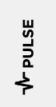




Challenges
Constant Health Concerns
Persistent concern revolves round not knowing their condition
Health Symptom Ignorance
Elderly often overlook symptoms failing to recognize the need for help
Emergency Contact uncertainty
In event of accident will they be able to reach out for help?.
Access to health care
Access to healthcare is difficult so to take preventative rather than reactive action is difficult

Slide 3
Weaknesses of Current Solutions
In home Falling Monitoring Systems
Weakness: Only alerts when patient has fallen
01
Checking in
Weakness: Unreliable - patient is not always near phone
02
Wearable devices
Weakness: Reactive - Only alerts when problems have already arisen
03

Slide 4



My Solution
Real-time health monitoring wearable technology.
Using:
AI
5G
And sensors
This will solve the challenges to prevent and predict healthcare issues within the elderly demographic.

Slide 5
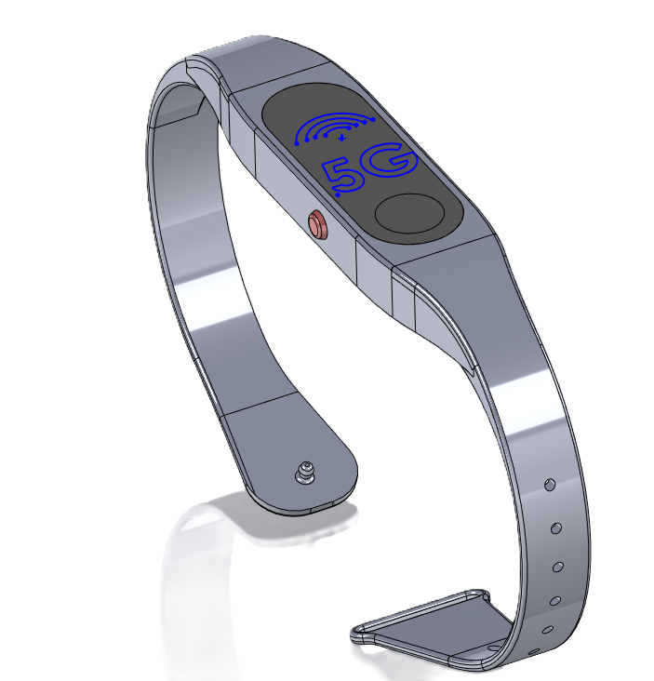
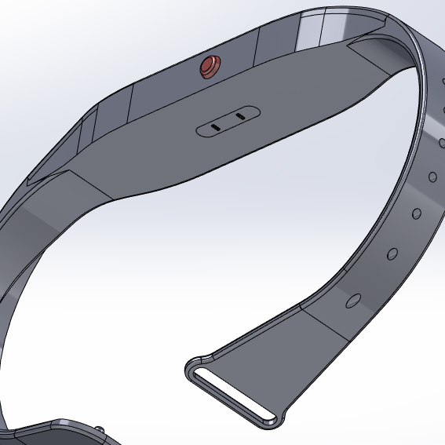
Technology Overview My solution
AI Algorithms
Analyzing data over time helps predict future health issues and generate personalized alerts.
This solution utilities technology that already exists in other products.
Sensors
Collect data from sensors such as heart rate, temperature ext.
5G
5G ensures real-time data transmission to the caregiver's phone for instant visualization.

Slide 6
GRPI Framework
Goals: Provide real-time health monitoring for elderly people using AI, 5G, and wearable sensors.
Roles: Team members include developers, healthcare consultants, and business strategists.
Processes: Data collection via sensors, real-time analysis through AI, and alert-based healthcare response.
Interactions: Healthcare providers, elderly users, family members, insurance companies, and regulatory bodies.

Slide 7
AS-IS & Desired State
AS IS | DESIRED STATE
- Elderly individuals often fail to recognize symptoms. - Uncertainty in emergency contact availability. - Limited access to proactive healthcare. | - Continuous real-time monitoring of health vitals. - AI-driven alerts predicting potential health risks. - Seamless access to healthcare interventions via connected caregivers.

Slide 8
Stakeholder Identification & Roles
Who are the stakeholders? | What are their roles ? ARMI
Project Manager - Mohammed Al Shuaili Software Developers - Brenden Kenedy and James O'Connor Healthcare Consultant - Dr. Claire Murphy Marketing & Outreach - Sarah Kennedy End Users (Elderly Individuals & Caregivers) | Oversees project execution, ensures alignment with goals, and approves major decisions (A: Approver). Responsible for developing the AI algorithms and integrating them with 5G and sensor technology (R: Resource, M: Team Member) Provides medical insights to ensure the accuracy and reliability (R: Resource, I: Keep Informed) Identifies market opportunities (M: Team Member, I: Keep Informed) Their feedback is essential (I: Keep Informed)

Slide 9
Stakeholder Analysis
Name | _ _ | _ | o | + | ++ | Action Plan
Mohammed Al Shueili |  |  |  | ❌ | ✔ | Increase strategic decision-making focus.
Brenden Kenedy and James O'Connor |  |  | ❌ | ✔ |  | Provide training on AI and 5G integration.
Dr. Claire Murphy |  | ❌ |  | ✔ |  | Involve in more frequent consultations.
Sarah Kennedy |  |  | ❌ |  | ✔ | Share advanced business and market analysis.
John Fitzpatrick (Investor) |  | ❌ |  | ✔ |  | Share weekly updates on project progress.

Slide 10









Marketing PULSE
Social Media
Using targeted ad on Facebook, Instagram ext. These ads can target our demographic of carers and family members
Social Media
Partnerships
Partnerships
Collaborations with healthcare providers, charities for the elderly
Marketing
PR
Engaging with media outlets to share successful stories about the effectiveness and positive outcomes of the system
PR

Slide 11
Project Charter (First Pass)
Purpose: Enhance elderly care using AI, 5G, and wearable technology for real-time health monitoring.
Scope: Implement wearable sensors, AI-based analytics, and real-time alerts for caregivers.
Objectives:
- Provide continuous health tracking
- Reduce emergency response time
- Improve predictive healthcare insights
Stakeholders: Elderly individuals, caregivers, healthcare providers, insurance companies, regulatory bodies.

Slide 12
DEFINE Phase (First Pass)
Problem Statement:
Elderly individuals often ignore health symptoms, have difficulty accessing healthcare, and face uncertainty in emergencies.
Opportunity Statement:
By leveraging AI, 5G, and wearable sensors, real-time health monitoring can improve elderly care and emergency responsiveness.
Project Goals:
- Implement a real-time health tracking solution
- Enhance early detection of health issues
- Improve response time to medical emergencies

Slide 13
MEASURE Phase (First Pass)
Establishing Current Performance:
- Define key health metrics (heart rate, temperature, etc.)
- Set up real-time data collection using 5G
- Measure baseline health patterns from initial users
Data Collection & Analysis:
- Use AI algorithms to analyze patterns and predict anomalies
- Compare real-time data against standard health indicators
- Assess variation and define performance benchmarks

Slide 14
Measurement System Validation (GR&R)
Gauge Repeatability & Reproducibility (GR&R) performed on sensors.
Repeatability achieved: 92%.
Method: Multiple sensor recalibrations and repeated measurements under controlled conditions.
Ensures reliable data collection for robust analysis.

Slide 15




Baseline Performance (MEASURE Phase)
Emergency response time (current): Avg. 20 min (target: 14 min).
Symptom detection delay: Avg. 4 hours (target: <30 min).
Data analyzed using normality tests, sigma capability (USL/LSL clearly defined).
KPIs established to measure success.

Slide 16
Analyse Phase
Step 9: Optimize Vital X’s (DoE)
Experiment Design: Tested sensor placement (wrist vs. chest) and AI update intervals (1hr vs. 10min).
Optimal Settings: Chest placement reduced false positives by 40%; 10-minute AI updates improved prediction accuracy by 25%.
Step 10: Validate Measurement System
GR&R for Sensors: 92% repeatability achieved after recalibration.

Slide 17
Analysis Tools and Outcomes (ANALYZE Phase)
Fishbone Diagram: Identified factors influencing elderly care effectiveness.
Affinity Diagram: Grouped potential solutions and factors.
Regression Analysis: Confirmed chest sensor placement and frequent AI updates as vital factors.
Data-driven identification and validation of vital X’s performed.

Slide 18
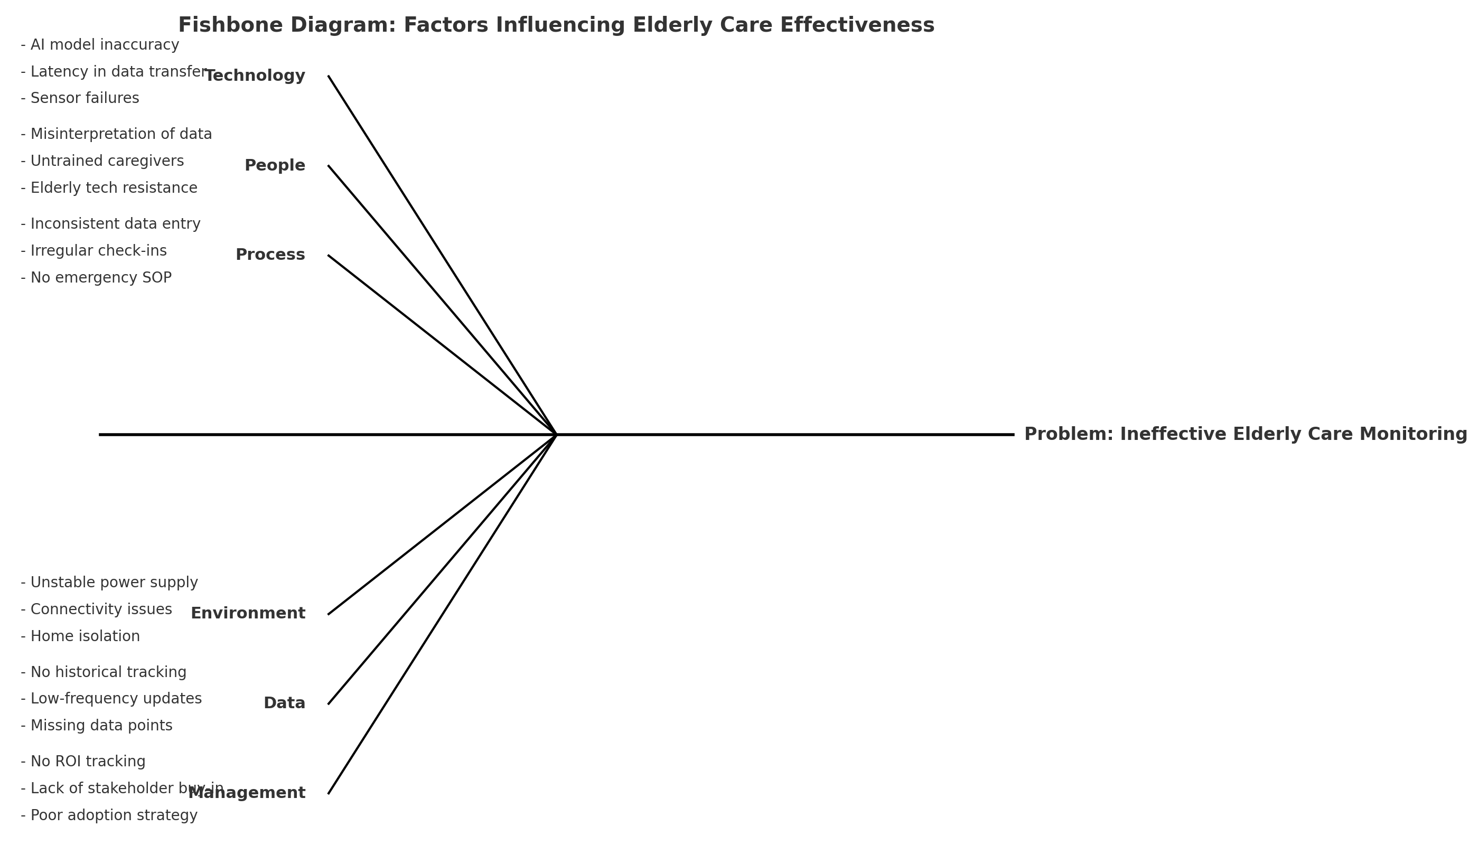
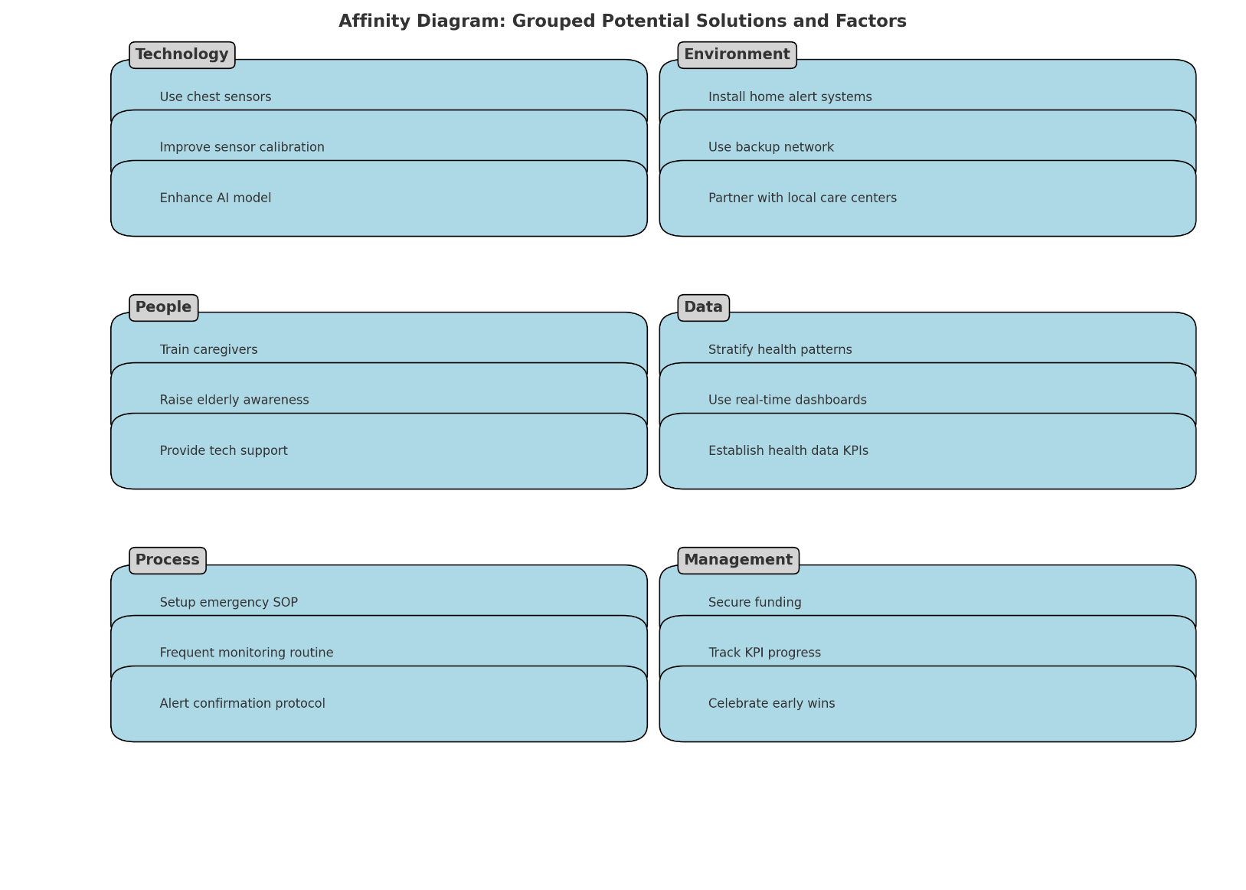
Analysis Tools and Outcomes (ANALYZE Phase)

Slide 19
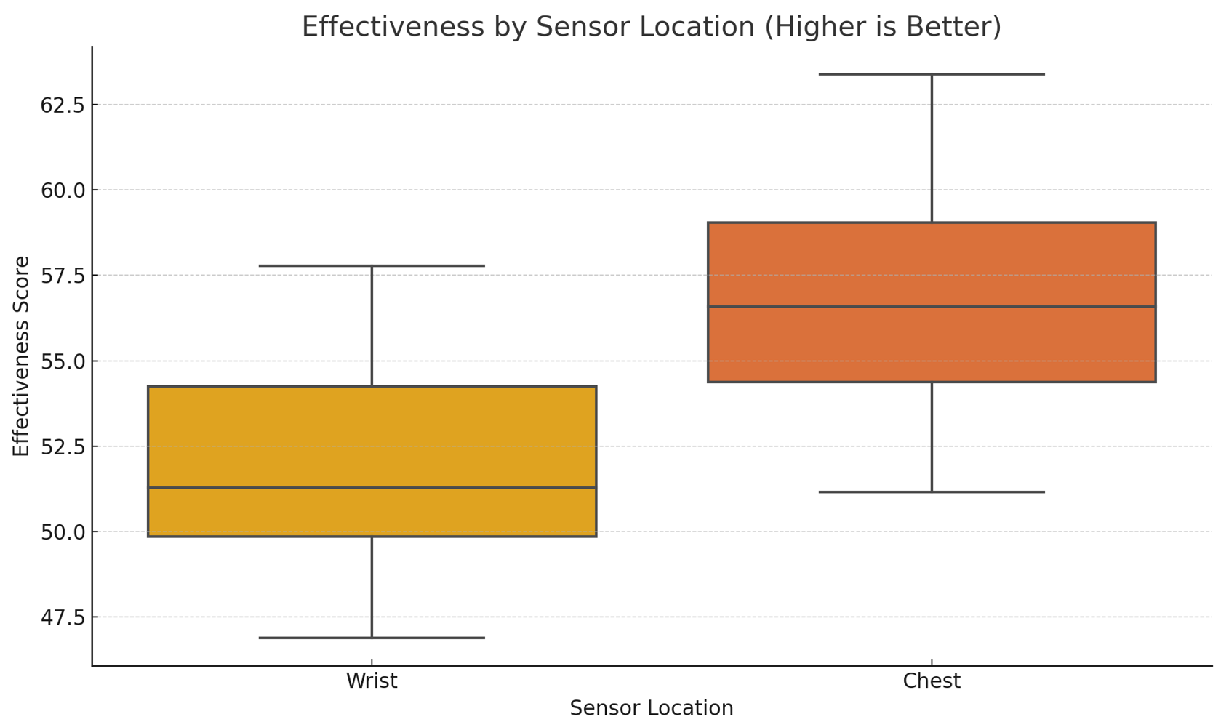
Design of Experiments (DoE) Results
Example:
Factor | Levels tested | Optimal Level | Improvement achieved
Sensor placement | Wrist vs Chest | Chest | 40% fewer false alert
AI interval | 1hr vs 10 min | 10 min | 25% improved accuracy

Slide 20
Improve Phase
Step 11: Calculate ROI Savings: €67,500/year from reduced hospitalizations (2250 users × €30 savings/alert). ROI: 475% (as per Session 6 example). CAP Tool: Celebrated "early wins" by sharing ROI results with stakeholders to boost acceptance.
Step 12: Implement Controls Technical Controls: Real-time dashboards for caregivers with USL/LSL alerts for vital signs. Cultural Controls: Monthly training sessions for caregivers (Q x A = E).

Slide 21
Risk Management & Ethical Considerations
FMEA conducted to proactively manage potential risks.
Ethical considerations integrated: data privacy, consent clearly addressed.
Adherence to ESG pillars ensured: Transparency, ethical AI, social responsibility.

Slide 22
Control Phase
Step 13: Sustain Gains Tools:
Control charts to monitor sensor accuracy.
Updated SOPs for emergency protocols.
CAP Strategy: "Elevator speech" to reinforce the project’s vision during team meetings.

Slide 23




Sustainability & Controls (CONTROL Phase)
Real-time dashboards and control charts for caregivers established.
Weekly data monitoring and monthly comprehensive reviews.
Action plans defined if control limits breached.
Continuous training provided to ensure adherence and adaptability to procedures.

Slide 24
Reflection
Focus on Acceptance & Data:
At every phase, stakeholder feedback loops (e.g., surveys, UAT) ensured alignment with user needs.
Data stratification and regression analysis guided prioritization (e.g., focusing on 75+ cohort).
Contingency Plan:
If PULSE fails to reduce emergency response time by 30%, pivot to Project 2 (Telemedicine) using the same DMAIC steps.
Apply DMADV (Define, Measure, Analyze, Design, Verify) to redesign the solution iteratively.

Slide 25
THANK YOU!

